Slide 1
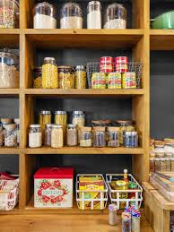
SMART PANTRY SYSTEM USING IOT
AMITHA A J
ROLL NO:14
MCA -A

Slide 2
RELEVANCE OF THE TOPIC
In Flatlife culture where everyone is busy,people cannot keep track of items or ingrediants that are running out of stock in their kitchen. Most of the times, when we want to buy an item from grocery we often can't remember which cooking ingredient (onion, garlic, chili etc.) is running low and some cases we buy wrong item such as garlic instead of onion.To get rid of such situations we can use this Smart Pantry system and can monitor the amount of every ingredients of the pantry. The data about the stock level of items will be continuously updated in this system.

Slide 3
DESCRIPTION OF THE PROJECT
This system provides IoT-based Smart Pantry level monitoring. The containers are fitted with FSR sensors. These are used to gather data about the stock level of items in the container. The data is continuously updated. The information includes the changes of weight in regular intervals of time. This system enables a user to view the level of items in a container from any place. The system alerts the user if the container's level goes below minimum weight. We are also using a PIR sensors to detect unusual presence of humans/animals.

Slide 4
OBJECTIVE OF THE STUDY
To study the working of Arduino with different sensors.
To understand operation of GSM module with Arduino .
To study function of different sensors like FSR sensor,PIR sensor.
To identify which container is running out of stock.
To send an alert message to the user to restock the item.

Slide 5
EXISTING SYSTEM
In the existing system a person often has to remember the quantity of fruit or vegetable in their home while shopping at the grocery store and sometimes they would end up buying the wrong quantity or the wrong vegetable, in some cases even if the person notes it down before leaving the home another person from the household may consume it and a particular fruit or vegetable may get exhausted.

Slide 6
PROPOSED SYSTEM
In the proposed system the user can view the quantity of particular vegetable or ingrediants from any place. This system provides updation of the weight of the items as it gets refilled or exhausted .
This system consists of a Force Sensitive Resistor(sensor),passive infrared sensor, Arduino, Wi-Fi module ,GSM module . The Force Sensitive resistor is fitted to each container. Then the Force Sensitive Resistors are connected to the Arduino. WIFI module is connected to the Arduino. The data can be viewed by user.

Slide 7
Force Sensitive Resistor (FSR) :
These are the sensors used in this system. It changes its value based on the force applied on it. The FSR is made of 2 layers separated by a spacer. The more one presses, the more of those Active Element dots touch the semiconductor and that makes the resistance go down. The weight of the stock in the container is calculated by the Arduino with the use of these sensors.
Arduino :
The system uses arduino nano. The sensors are connected with it. It receives the data from the sensors. Arduino Nano Pinout contains 14 digital pins, 8 analog Pins, 2 Reset Pins & 6 Power Pins.The arduino is also connected to wifi module.

Slide 8
GSM Module:
The GSM module is used to establish communication between mobile devices. In this system it is used to send alert messages about lower stock levels.
Wi-Fi module:
It is used to establish connection to a Wi-Fi network. The ESP8266 WiFi Module is a self contained SOC with integrated TCP/IP protocol stack that can give any microcontroller access to your WiFi network. Each ESP8266 module comes pre-programmed with an AT command.

Slide 9
MODULES
Sensing the force applied.
Processing.
Communication
data displaying.

Slide 10
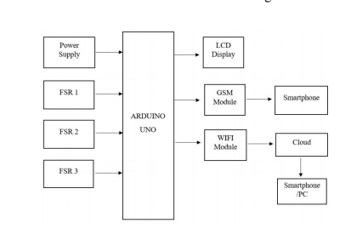



SYSTEM ARCHITECTURE

Slide 11
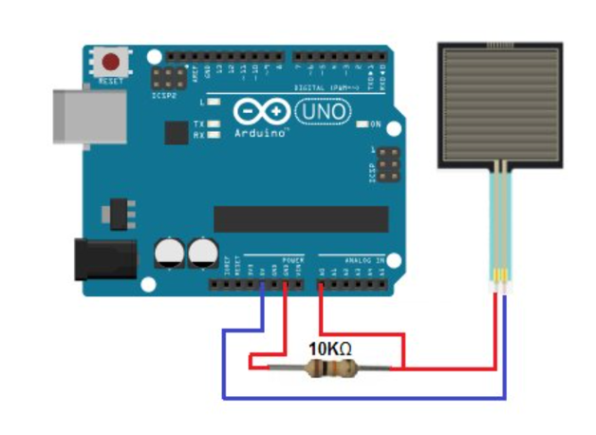
Interfacing Force Sensing Resistor (FSR) with Arduino

Slide 12
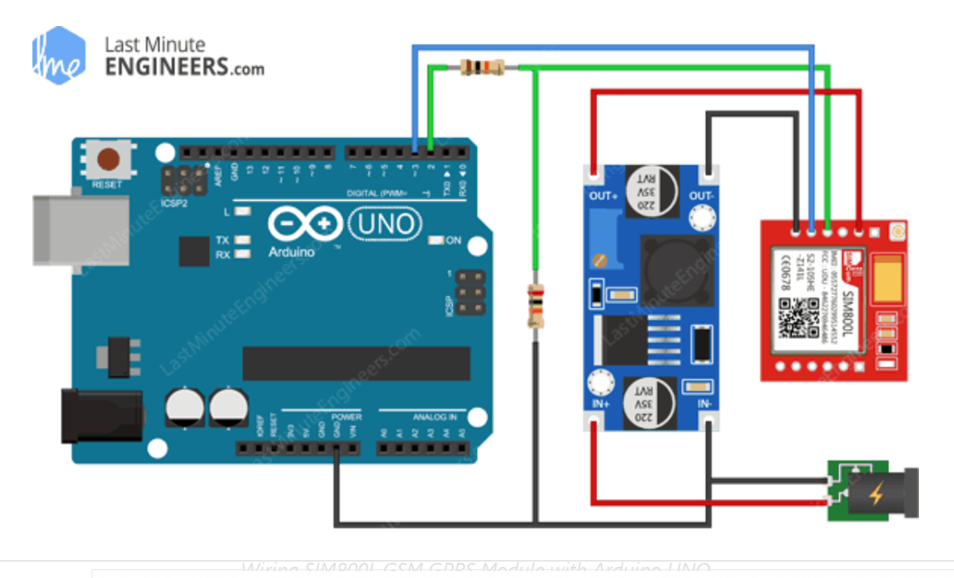

Interfacing GSM Module with Arduino

Slide 13
HARDWARE COMPONENTS
Force Sensitive Resistor (FSR)
PIR sensor
GSM module
Wifi module
SOFTWARE COMPONENTS
Arduino IDE

Slide 14
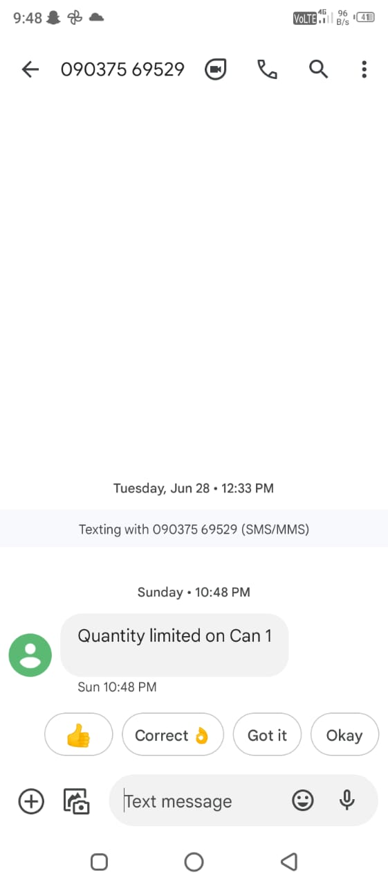
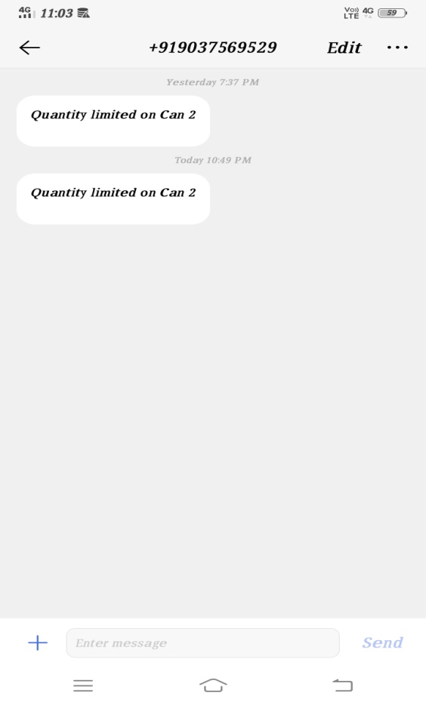
OUTPUT SCREENSHOTS

Slide 15
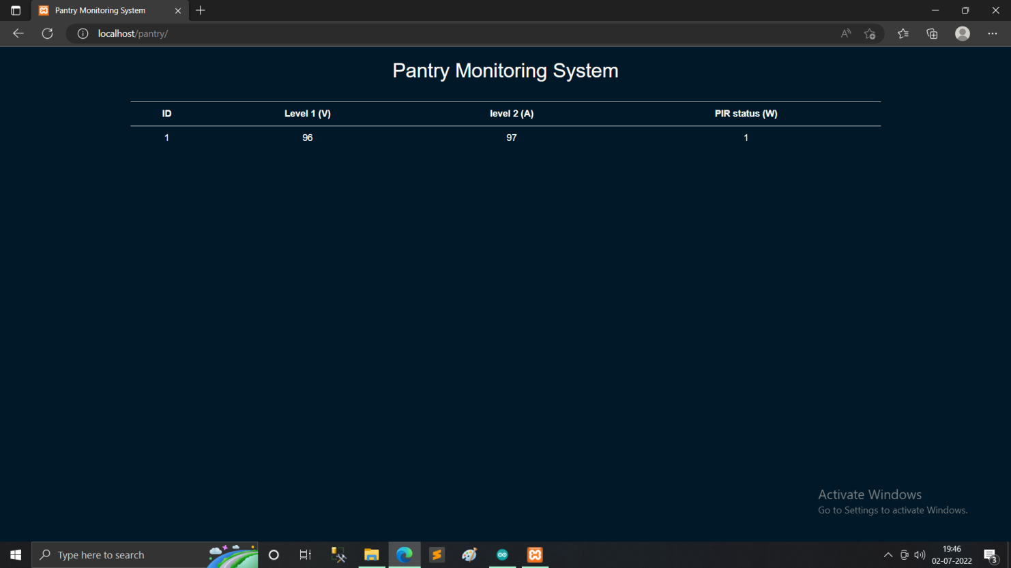

Slide 16
THANKYOU

